Slide 1
High cloud Analysis
Presented By Group 5

Slide 2
Mentors Himavanth Gandam Pranay Kumar
Team members Manali S Parab Nakshtra Vankudre Jyothi Patil Sanjay B S Shaikh Taha

Slide 3
Contents
Introduction
Business Overview
Project Scope
Data Model Challenges
Dashboard Overview
Suggestions And Comments

Slide 4
objectives
To gain a comprehensive understanding of 'High Cloud Airlines' operations through data analysis. This will involve investigating load factor, identifying top carrier names based on passenger preference, analyzing popular routes, and exploring other key metrics. The ultimate goal is to provide actionable recommendations that can enhance operational efficiency and profitability.

Slide 5

Introduction to high cloud
“To revolutionize the airline industry through data-driven insights and optimization”

Slide 6
Business Overview
In today's competitive airline industry, data analysis plays a critical role in optimizing operations and maximizing profitability. By harnessing the power of data, High Cloud Airlines can gain valuable insights into various aspects of its business, allowing them to make data-driven decisions that can lead to • Improved Load Factor • Enhanced Passenger Experience • Optimized Resource Allocation • Data-Driven Decision Making

Slide 7
Project Scope
This project aimed to leverage the power of data analysis and extract valuable insights to optimize High Cloud Airlines operations and performance. The specific scope of the project focused on analyzing key performance indicators (KPIs) to gain a deeper understanding of: • Load Factor • Passenger Preferences • Popular Routes • Operational Efficiency

Slide 8
Data Model Challenges
Throughout our analysis, we encountered various challenges in handling the data. Overcoming these challenges is crucial for accurate insights. • Data Volume: Managing and processing large datasets efficiently. • Data Quality: Ensuring accuracy and reliability of the data. • Complex Relationships: Establishing connections between different data points.

Slide 9
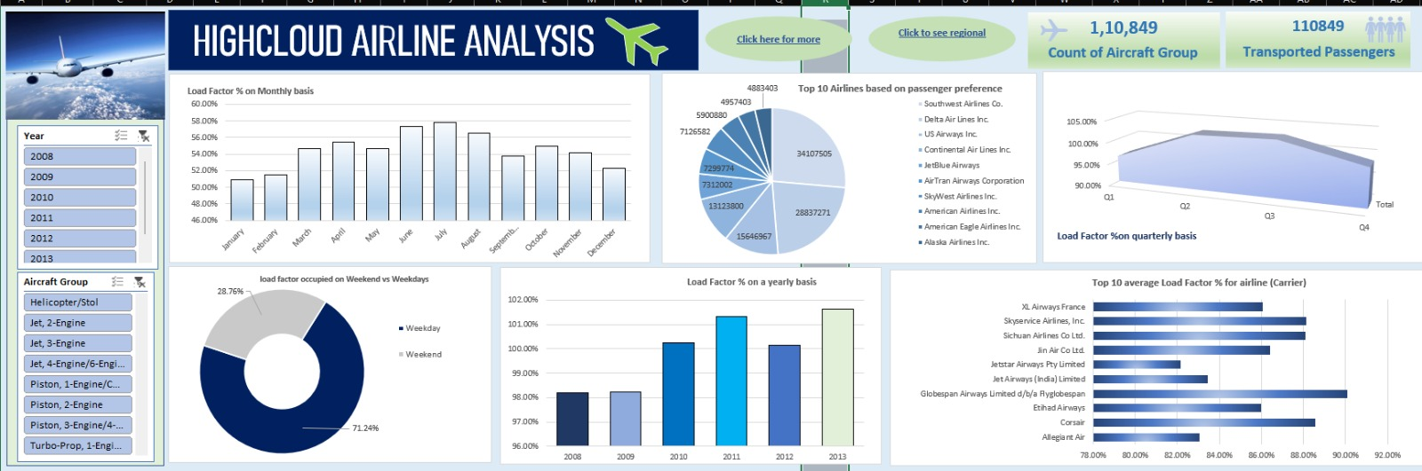
Excel Dashboard

Slide 10
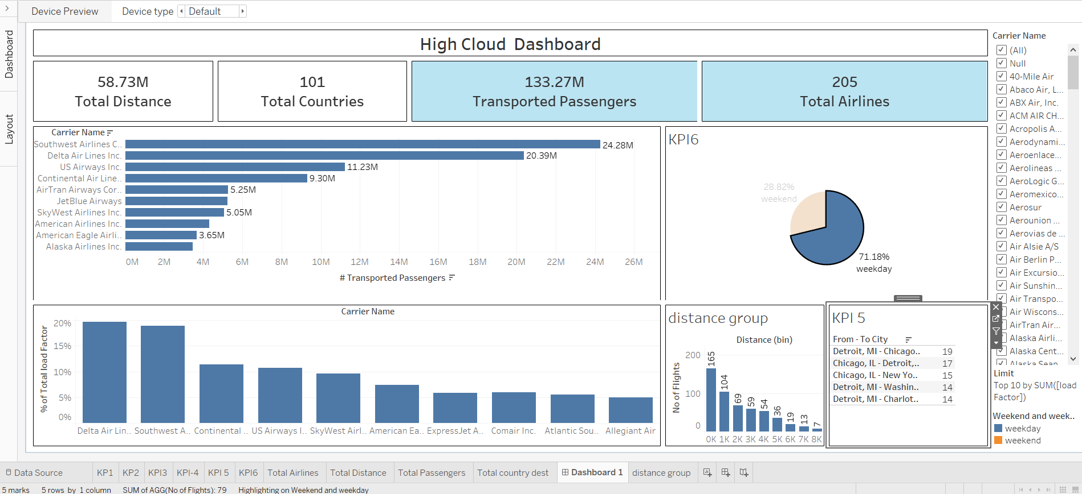
Tableau Dashboard

Slide 11
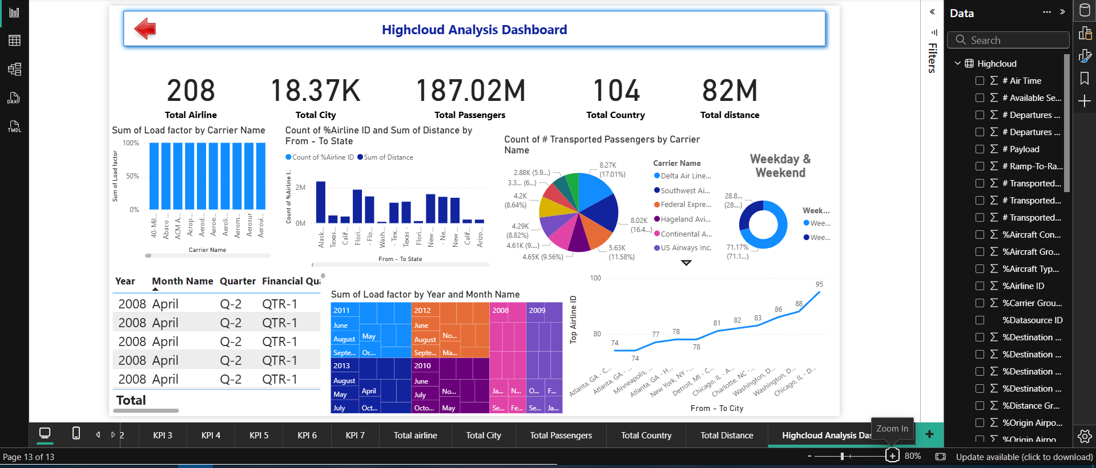
Power bi Dashboard

Slide 12
Recommendations
• Optimize Flight Routes: Utilize insights from top routes and flights to optimize schedules and resource allocation. • Enhance Load Factor: Leverage load factor analysis to identify trends and implement strategies for increased efficiency. • Strategic Carrier Partnerships: Collaborate with top carriers to maximize passenger transportation and enhance overall performance. • Resource Allocation: Allocate resources strategically based on flight schedules and passenger volume data, This ensures efficient operations and minimizes wait times at airports with high passenger traffic.

Slide 13
Conclusion
High cloud Analysis empowers the aviation industry with actionable insights, fostering efficiency and strategic decision-making. The presented KPIs offer a glimpse into the vast potential for improvement and growth within the industry. By harnessing the power of data, we can drive positive changes, ensuring a brighter future for High Cloud Analysis and its partners in the aviation sector.

Slide 14
Thank you

